Slide 1

DATA SCIENCE AND ANALYTICS: PROJECT ONE
Predicting House Values in Ames, Iowa
Group 6
Members: Chris Holt, Lawrence Ferretti, Julian Freeman, Courtenay Gray, Jason Ree, Jamie Thorpe

Slide 2

Dream House
TOPICS TO COVER
Motivation / Hypothesis
Data Observation
Data Analysis
Hypothesis Testing
Summary of Data
Group 6| Predicting House Values in Ames, Iowa

Slide 3

It can be said that owning a home is a part of the American dream.
Notes:
Motivation Slide
* Define the core message or hypothesis of your project.
It’s part of the American dream to own one’s own home.
* Describe the questions you asked, and _why_ you asked them
But what characteristics of houses affect the prices of houses most substantially? Unlike any other asset, houses are one of the most difficult to properly assess its value.
* Describe whether you were able to answer these questions to your satisfaction, and briefly summarize your findings
Through this project we were able to discover a strong model that accounts for the targeted 5 variables’ affect on housing sale prices

Slide 4

Overview
DATA
Over 70 variables describing various aspects of residential homes in Ames, Iowa
GOAL
To predict the final price of each home using 5 characteristics (Lot Area, Overall Quality, Year Remodeled, Living Area, Basement Area) of houses from the data.
SOURCE
Kaggle
Notes:
Question / Data Slide:
* Elaborate on the questions you asked, describing what kinds of data you needed to answer them, and where you found it
-the main purpose of our study was to explore whether the 5 chosen housing characteristics were the most influential characteristics in determining sales price
-and to find a model based on our data to predict sales price
-the housing data of 1460 houses with 79 housing characteristics provided via Kaggle was an ample source of information to test our hypothesis

Slide 5

Our Hypothesis
PREDICTION BASIS ON HOUSING PRICES
H₀: Five characteristics have no effect on housing prices in Ames, Iowa.
H_{a}: Five characteristics have an effect on housing prices in Ames, Iowa.
Group 6| Predicting House Values in Ames, Iowa
Notes:
With 79 explanatory variables describing (almost) every aspect of residential homes in Ames, Iowa, the goal was to predict the final price of each home of the testing data using the training data set.
Explain :H0 and HA (why)

Slide 6

Data Observation
Initial Observation
35 Numerical Columns
44 Categorical Columns
1460 Rows of data
DATA
Sales Price Distributions (Histograms)
5 house features (from research question) vs. Sales price plots
Notes:
* Discuss insights you had while exploring the data that you didn't anticipate
* Discuss any problems that arose after exploring the data, and how you resolved them

Slide 7
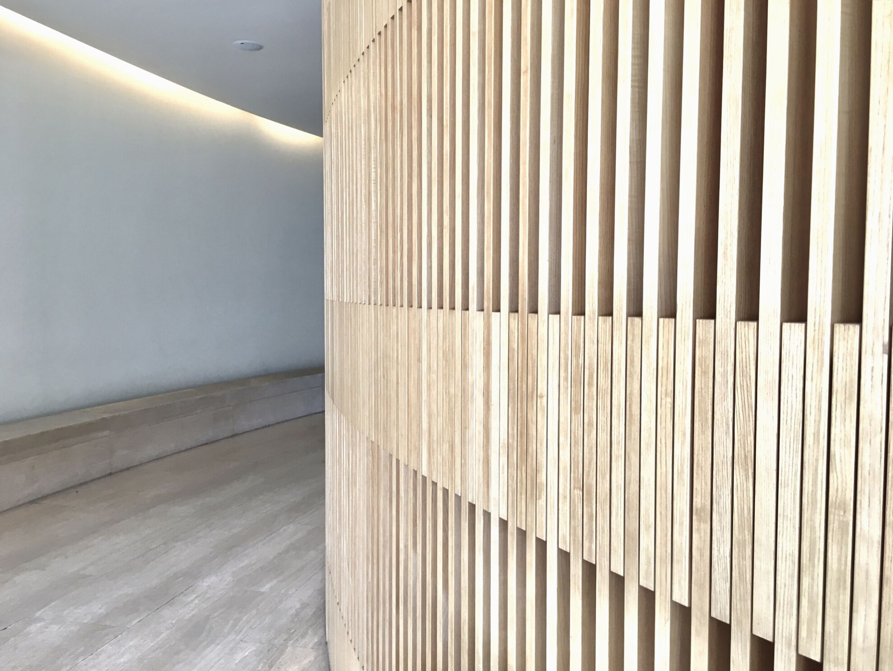
Data Clean-up
DATA MUNGING
DATA CLEANING
DATA TRANSFORMATION
Group 6|Predicting House Values in Ames, Iowa
Notes:
talk about data munging and transformation . We did data munging and cleaning. There wasn’t much to mung
* Describe the exploration and cleanup process
The dependent variable (sales price) and 5 target variables were checked for missing values/NAs/NaNs.
None were found, however we found that other characteristics, such as the presence of fireplace, alley, and fence had upwards of 90% NAs
Fortunately our target independent variables did not have any missing data
also categorical variables were dealt with using label encoder and converting them to dummy variables. however, the 5 target variables we chose to study for this project were not subject to this conversion.

Slide 8
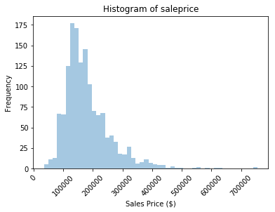
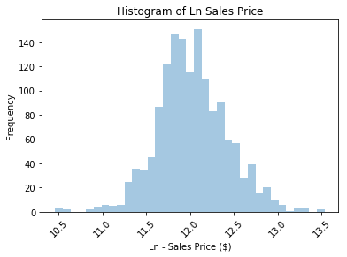
Observation of “Sales Price Distribution”
Histogram Data
Sales Price
Natural Log of Sales Price
Notes:
* Present and discuss interesting figures developed during exploration, ideally with the help of Jupyter Notebook
-The natural log of sale prices has a normal distribution

Slide 9

Housing Characteristics
YEAR REMODELED
Homes built, then remodeled between 1950 and 2010
LOT AREA (SQ FT)
Home’s total lot area
LIVING AREA (SQ FT)
Home’s above ground living area
TOTAL BASEMENT (SQ FT)
Home basement square footage (0 for homes without one).
OVERALL QUALITY
Homes ranked on a scale of 1 to 10
Notes:
Out of the 79 housing characteristics, our group believed the selected 5 would have the most influential impact on sales prices and constructed our hypothesis based on these characteristics.

Slide 10
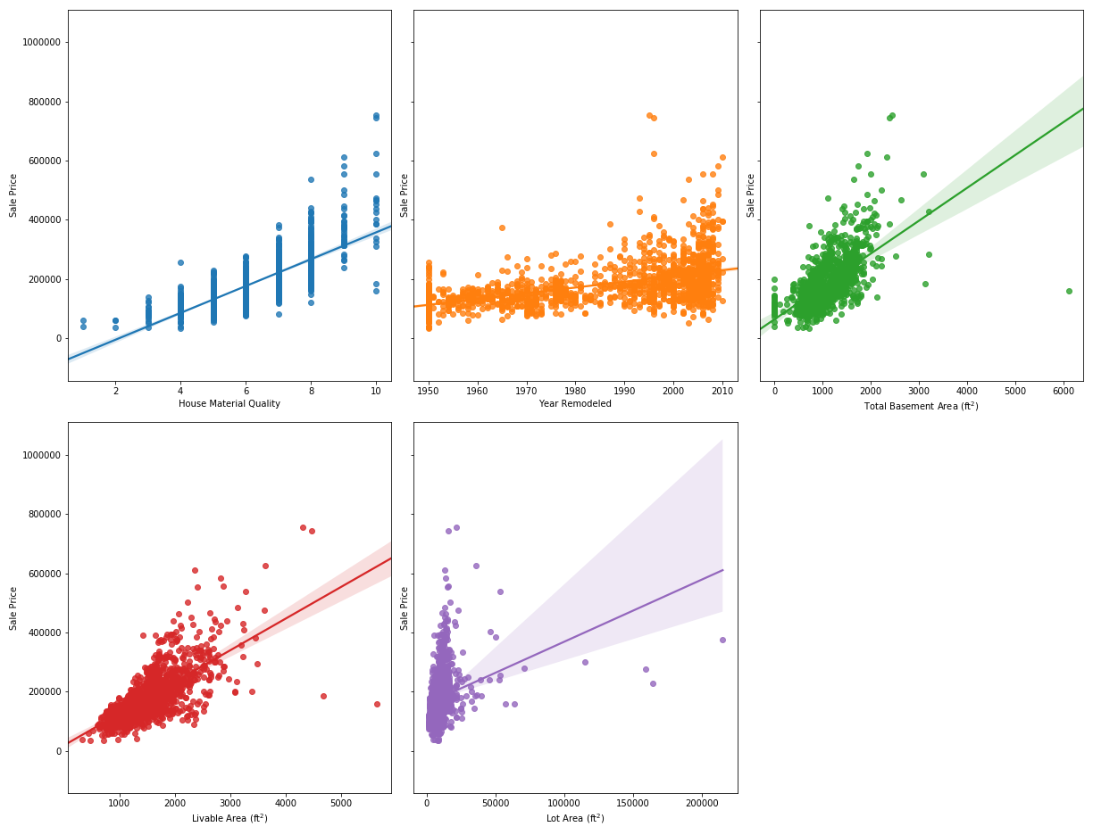
One-Way Plots
Julian resized Plots will go here
House Material Quality
Year Remodeled
Total Basement Area
Notes:
Discuss one-way plots vs Sales prices
House Material Quality(overall quality)
Year remodeled
Total Basement area (you may want to discuss the one “outlier”or rather the one dot that is away

Slide 11
One-Way Plots (cont.)
Julian resized Plots will go here
Livable Area
Lot Area
Notes:
Discuss one-way plots vs Sales prices
Livable Area
Lot Area

Slide 12
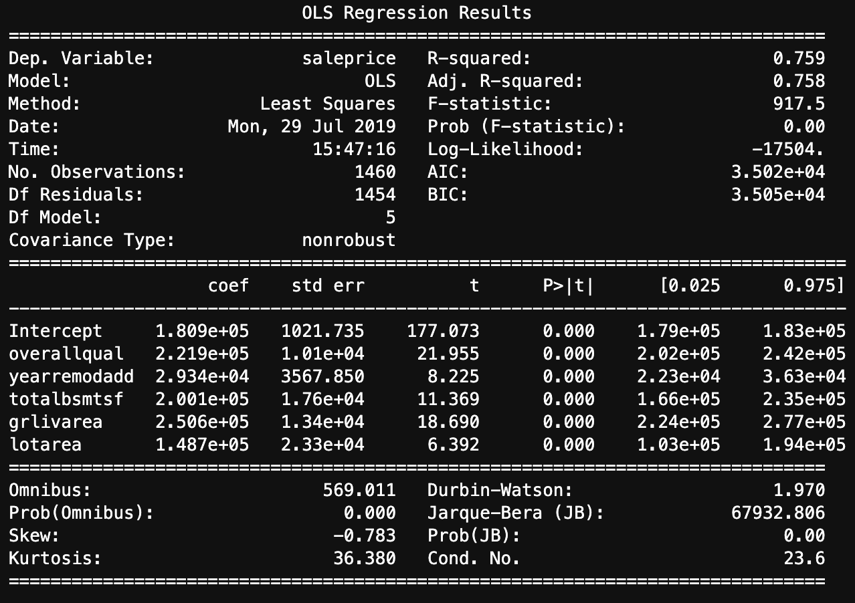
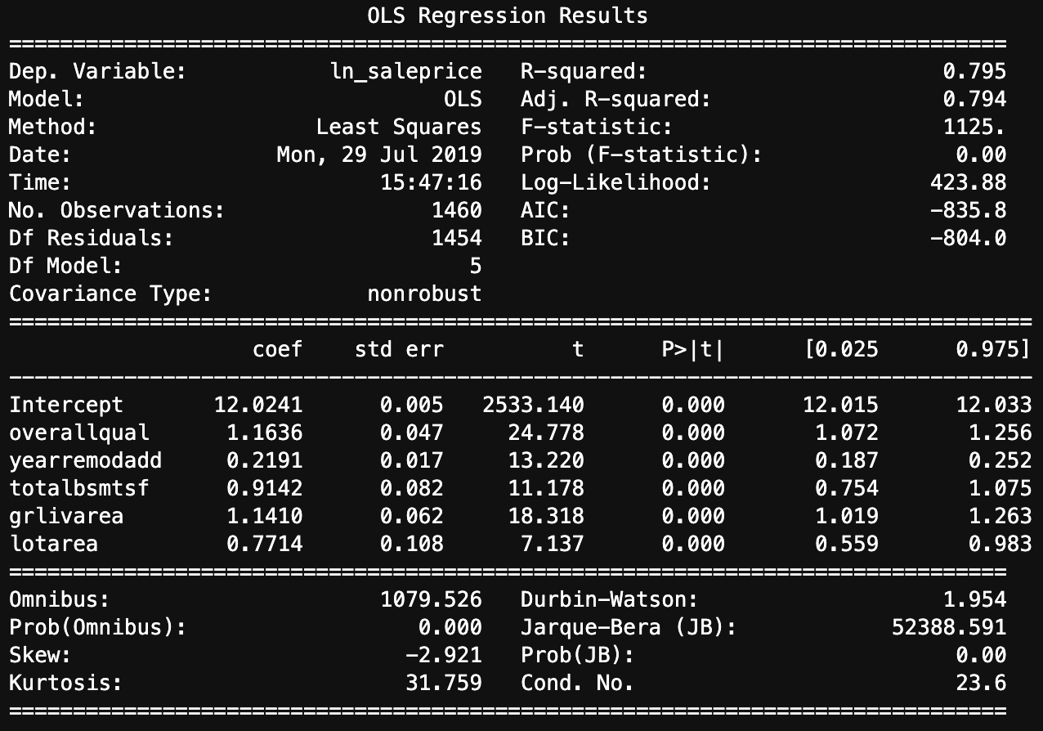
Regression Analysis - Ordinary Least Squares
Julian resized Plots will go here
Sales Price
OLS Regression Results
ln(Sales Price)
====================
R-squared: 0.795
P-value: 0.000
t-Test: 0.471
ln(Sales Price)
Notes:
Made this duplicate because the format looks better for two OLS windows.

Slide 13
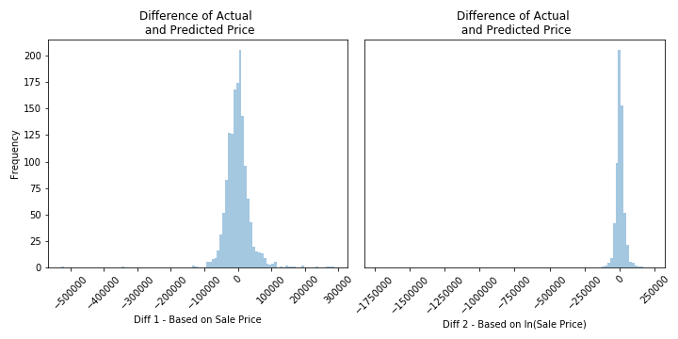
Residual Plots
Notes:
chart= results of our models r2 values of add charts ( diff of actual predicted price and diff of actual )

Slide 14

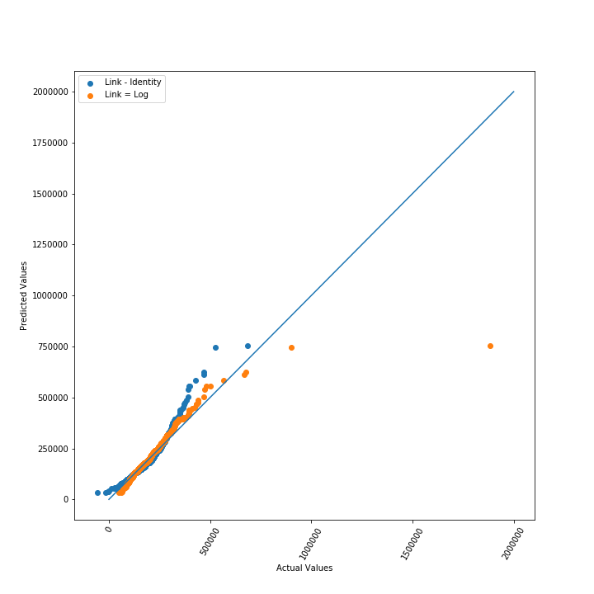
Quantile-Quantile Plot
Notes:
QQ Plot
natural log of sale price has more normal fit than sale price
the natural log has two points that are outliers however this shows that housing prices in the real world are not always linear or there may be other factors that may affect the pricing (such as the house is haunted)
-which model are we gonna take and why
we take the OLS model – LN sales
because of higher R2 and the spread of residuals looks more normal
QQ plot of natural log has more normal fit

Slide 15
Hypothesis Testing
P-Value
0.000
R-Squared
0.795
T-Test
0.471
ln(Sale Price)
Notes:
-which model are we gonna take and why
we take the OLS model – LN sales
because of higher R2 and the spread of residuals looks more normal
QQ plot of natural log has more normal fit
after assessment of the two models
the QQ plot illustrates the ln(saleprice) having a more normal fit
r2 of 0.795 shows that the model fits data well
t-test
r2: 0.795 fit is pretty good
t-test shows that with .471, we accept the null hypothesis

Slide 16

Machine Learning
Process
Predictive Model
.Google AI Platform
Scikit-Learn
Multiple Linear Regression
Backward Elimination
Notes:
Explain the process and the predicted model outcomes

Slide 17
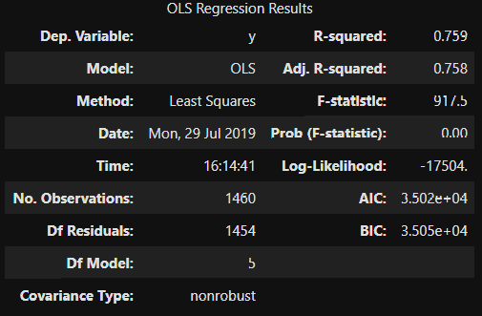
Machine Learning
Least Impactful
Year Remodeled R-squared = 0.257
Lot area R-squared = 0.070
Notes:
Explain the process and the predicted model outcomes

Slide 18

Our Conclusion
DID WE ACCEPT OR REJECT THE NULL?
-The 5 selected housing characteristics have a significant impact on sale prices
- OLS model of ln(saleprice) illustrated promising results for sale price prediction
Group 6| Predicting House Values in Ames, Iowa
Notes:
Discuss why we rejected the null
-The 5 selected housing characters have a significant impact on sale prices
- OLS model of ln(saleprice) illustrated promising results for sale price prediction
- impact on sale price ranking (most to least): (based on Rsquared comparisons with modelling with feature exclusions)
Overall Condition
Living Area
Basement Area
Year Remodelled
Lot Area

Slide 19

Questions

Slide 20

Appendix
Observations of ALL 79 features
Why not observe all 79 house features’ effects on sales prices?
Notes:
Additional data: Discuss the finding of these features dealing with categorical data & one- way plots

